Slide 1
CH5 Stack & Queue revision + Intro to Trees

Slide 2

Agenda
Queue Revision
Stack Revision
Trees Intro
Image: Pixabay

Slide 3

1. Stack
ADT = Abstract Data Structure
It is a concept that can be recreated in any coding language.
LIFO = Last-In/First-Out
Last element we put in, is the first one to be taken out
Can be implemented using a Linked List for example or in many other ways!
Image from GettyImages

Slide 4
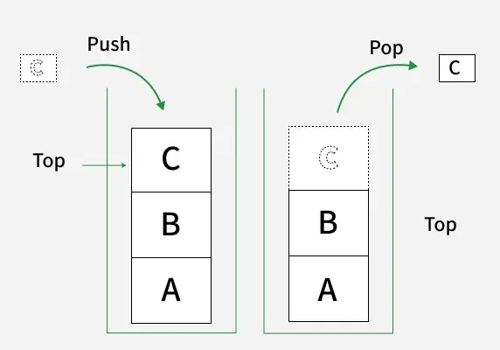
1.1. Stack
Stack operations in Python:
Push: Adds a new element on the stack.
Pop: Removes and returns the top element from the stack.
Peek: Returns the top (last) element on the stack.
isEmpty: Checks if the stack is empty.
Size: Finds the number of elements in the stack.
Used in undo mechanisms, to revert to previous states, to create algorithms.
Image from GettyImages

Slide 5

2. Queue
ADT = Abstract Data Structure
FIFO = First-In/First-Out
First element we put in, is the first one to be taken out
Can also be implemented using a Linked List for example or in many other ways!
Image from Freepik

Slide 6
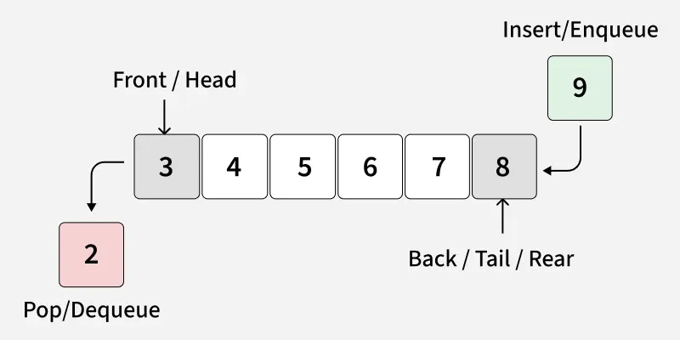
2.1. Queue
Basic Operations:
Enqueue: Adds a new element to the queue.
Dequeue: Removes and returns the first (front) element from the queue.
Peek: Returns the first element in the queue.
isEmpty: Checks if the queue is empty.
Size: Finds the number of elements in the queue.
Used in job scheduling for an office printer, order processing for e-tickets, or to create algorithms

Slide 7
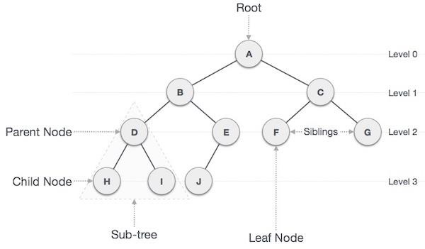
3. Trees
= non-linear abstract data type (ADT) with a hierarchy-based structure.
Consists of Nodes with Links!
Used to organize data, enable fast searching, and manage nested relationships.
Common applications include file systems, decision-making algorithms, and compilers.

Slide 8
3. Trees
Path − Path refers to the sequence of nodes along the edges of a tree.
Root − The node at the top of the tree is called root. There is only one root per tree and one path from the root node to any node.
Parent − Any node except the root node has one edge upward to a node called parent.
Child − The node below a given node connected by its edge downward is called its child node.
Leaf − The node which does not have any child node is called the leaf node.
Subtree − Subtree represents the descendants of a node.
Visiting − Visiting refers to checking the value of a node when control is on the node.
Traversing − Traversing means passing through nodes in a specific order.
Levels − Level of a node represents the generation of a node. If the root node is at level 0, then its next child node is at level 1, its grandchild is at level 2, and so on.
Keys − Key represents a value of a node based on which a search operation is to be carried out for a node.

Slide 9
3. Trees
Path − Path refers to the sequence of nodes along the edges of a tree.

Slide 10
3. Trees
Root − The node at the top of the tree is called root. There is only one root per tree and one path from the root node to any node.

Slide 11
3. Trees
Parent − Any node except the root node has one edge upward to a node called parent.

Slide 12
3. Trees
Child − The node below a given node connected by its edge downward is called its child node.

Slide 13
3. Trees
Leaf − The node which does not have any child node is called the leaf node.

Slide 14
3. Trees
Subtree − Subtree represents the descendants of a node.

Slide 15
3. Trees
Visiting − Visiting refers to checking the value of a node when control is on the node.
Levels − Level of a node represents the generation of a node. If the root node is at level 0, then its next child node is at level 1, its grandchild is at level 2, and so on.
Keys − Key represents a value of a node based on which a search operation is to be carried out for a node.

Slide 16
3. Trees
Lastly, let’s look at an Example of a Binary Search Tree! ☺
https://www.cs.usfca.edu/~galles/visualization/BST.html
https://visualgo.net/en/bst

Slide 17
See you next time!
tino.kankkunen@metropolia.fi

